Slide 1
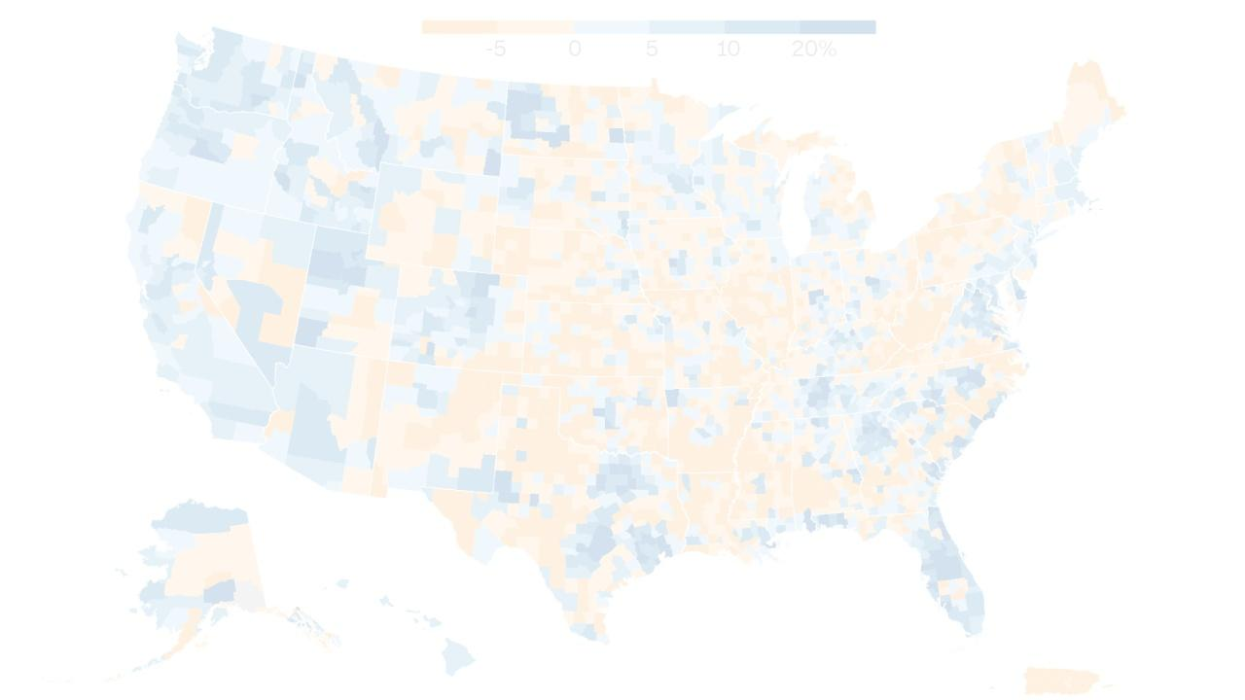
EAS 345
Section A
Bayesian Improved Surname and Geocoding (BISG)
Sander O’Neil
Sep 26

Slide 2
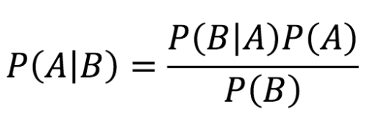
Bayes Rule
Bayesian Improved Surname Geocoding (BISG) is a statistical model that applies Bayes' Theorem to find the race/ethnicity of a person using their surname and geolocation.
Bayes’ Theorem also known as Bayes’ Rule is simply stated as:
This can be read as The probability of A given B, is the probability of B given A times the ratio of A to B.
For instance,Given a dataset of people from NY state, if 4 percent of people live in Buffalo, 5 percent of people are fans of the Buffalo Bills, and if 80 percent of people in Buffalo root for the bills, what is the probability that a fan of the bills is from buffalo?
P( From Buffalo|Fan of Bills ) = P(Fan of Bills|From Buffalo)P(From Buffalo) / P(Fan of Bills)
P(From Buffalo|Fan of Bills) = (.80)(.04)/ (.05)=0.64
This statistical method can be used to give racial categorization or data to datasets which are missing this point but have surname and geolocation data. This data is important if an organization wants to find out the demographics of a group for purposes like analyzing discrimination in hiring, insurance or healthcare outcomes

Slide 3
Why Would You Want to Infer Race/Ethnicity Data?
To analyze racial disparity in datasets such as:
Hiring algorithms
Insurance rate algorithms
Loan scoring algorithms
Healthcare outcomes
Dynamic Pricing algorithms
Advertising algorithms

Slide 4
Background
Since the rise of algorithms being used to categorize people they have been soaking up inherent bias in pre-existing datasets.
Whenever any algorithm is trained on pre-existing data the pre existing data is at risk of contaminating the new algorithm with its bias.
Example: G.E. trains a hiring algorithm on data of who it hired since 1920. It will likely notice that the employees in its dataset were only men for multiple decades and make decisions on that information from now on.
Or accidental bias.
Example: A Michigan based company uses their hiring algorithm in Texas, and the algorithm continues to hire only people from Michigan.
Recently government entities have begun to regulate this bias, but it is difficult as many statistical models have no exact number which represents their likelihood to hire a woman or an asian person, instead these hiring algorithms are complete black boxes unknown even to the data scientists who create them.

Slide 5
Why Might data be absent
People may choose not to fill out demographic information because they are worried that they will be discriminated against if they do.
Analyzing data without taking into account those who have not given their information may lead to overlooking bias in the gathering of demographic data, for example, the Census attempts to report on data for illegal immigrants but many do not fill out census forms because they fear the information may be given to U.S. Immigration and Customs Enforcement's (ICE), which in fact it is not.

Slide 6
Plan Of Work
Most of the work done for this project will be building the final model.
Firstly the data needs to be sourced from the U.S. census, the data should include enough demographic precision that 19,000 incorporated Cities and Towns
The precision of the demographic data should be standard U.S. Census precision, so race as one of the following: Black, White, Asian, Native/Pacific Islander, and Hispanic Status should all be collected.
Racial data per surname should be collected, This will not be difficult. (Decennial Census Surname Files (2010, 2000), 2016)
The most difficult part of data collection will be Surnames Geodata correlation, part of this is because the census likes to protect the privacy of peoples data and so does not release data that could lead to personal conclusions. For instance if there is a town with only one person with a surname it is unlikely the census would want to provide the racial data for that surname as it would basically be giving racial data on a specific person.

Slide 7
Plan Of Work 2
The next stage of the project would be data analysis and cleaning. It would be important to analyze the data gained so far to see if it will fit the scope of the project, and if the project should be modified or more data gathered. Data may need to be cleaned for processing. Towns could possibly have their data quantified from text data. The next stage would be the initial building of the model. Based on the structure of the data gained so far Posterior probability should be built and all data should be summed upon the correct axes to convert statistics into probabilities.
If the model evaluates well than it should be coded into a form which can be easily used by a client like a single command line python function which asks for a 2 by n array of [surname, zip code] and returns a 2 by n array of [racial predictions, confidence level]

Slide 8
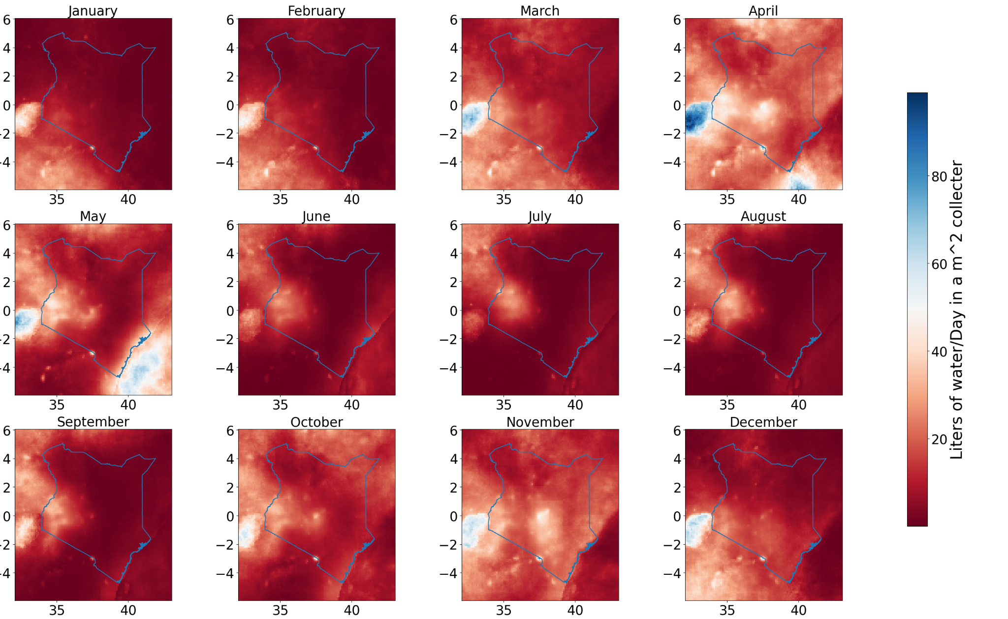
Qualifications And Experience
On a personal note, My mother is Catherine O’Neil, the CEO of ORCAA, an algorithmic auditing corporation which works on this sort of thing. My grandma, Elizabeth O’Neil, is thinking about coding a model similar to this. I asked them what a good Idea was for this project and they suggested BISG. They often attempt to evaluate models for racial bias and not having racial data can often be a detriment, so this kind of algorithm could assist in their work.
Figure, Previous project utilizing Nasa dataset with numpy

Slide 9
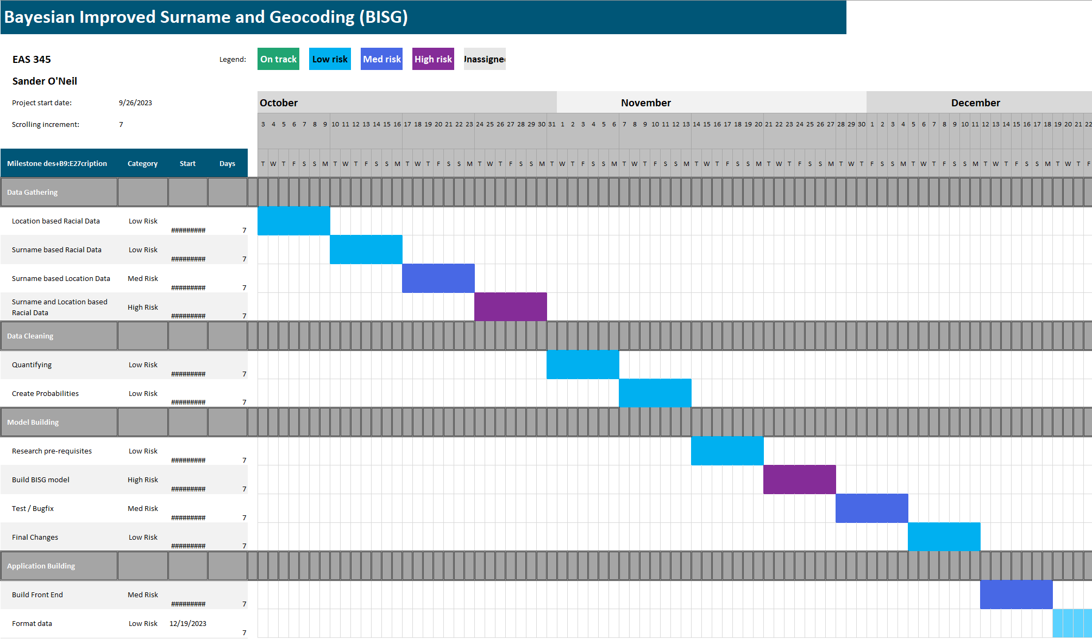

Slide 10
Conclusion
Bayesian Improved Surname and Geocoding (BISG) is a useful algorithm to create guesses/assumptions as to the racial or ethnic information of an individual which has not given their information explicitly. This can be helpful in cases where there is a possibility of discrimination which should be tested for but there is incomplete data on the demographics possibly being discriminated against.
In recent years algorithmic auditing has become a legally mandated profession and will only get more necessary for corporations going forward. Because of anti-discrimination laws, companies are often not allowed to collect demographic data about their employees or clients. Still it is sometimes necessary to assess the demographics of outcomes of processes like hiring insurance and healthcare.

